Slide 1

Seasonal Agriculture Performance Analysis
FULL NAME : Mallepula Prashanthi
COLLEGE NAME : Matrusri Engineering College
AICTE STU ID : STU661e7cc98e8471713274057

Slide 2

PROBLEM STATEMENT
Agricultural activities are influenced by seasonal variations in environmental conditions, farming practices, resource availability and market conditions. As a result, agricultural performance may differ from one season to another. However, raw agricultural data does not clearly explain how agricultural performance changes across seasons or what patterns can be observed in different seasonal conditions. The problem is to analyze the given agricultural dataset and investigate seasonal differences in agricultural performance by identifying meaningful patterns, trends, relationships and variations within the available data.

Slide 3
Project Description
Analyzed a farm-level agricultural dataset of 4,000 records across 8 states, 10 districts, 8 crops, 3 seasons (Kharif, Rabi, Zaid) and 4 irrigation methods.
Cleaned missing values (season+crop-aware median imputation) and capped unrealistic outliers in yield and water-efficiency using the IQR method.
Engineered new metrics — Profit Margin %, Cost/Revenue per Hectare, and total NPK intensity — for fairer cross-farm and cross-season comparison.
Explored environmental conditions, resource usage, yield, and profitability across seasons using visual and statistical analysis.
Applied Kruskal-Wallis hypothesis tests to confirm which seasonal differences are statistically significant, not just visual.
Derived evidence-based insights and recommendations to support season-specific agricultural planning.

Slide 4

WHO ARE THE END USERS?
Farmers and farmer cooperatives choosing crops and irrigation methods by season
State agriculture departments and policymakers designing seasonal advisories
Agri-business, agri-fintech and crop-insurance companies assessing seasonal risk
Agricultural researchers and students studying seasonal performance patterns
Agri-input companies (fertilizer, seed, irrigation equipment) planning seasonal demand and supply

Slide 5

Technology Used
Python 3 — core programming language for the analysis
Pandas & NumPy — data cleaning, wrangling and feature engineering
Matplotlib & Seaborn — exploratory data visualization
SciPy (stats) — Kruskal-Wallis hypothesis testing
Jupyter Notebook — analysis environment and documentation
GitHub — version control and project submission

Slide 6
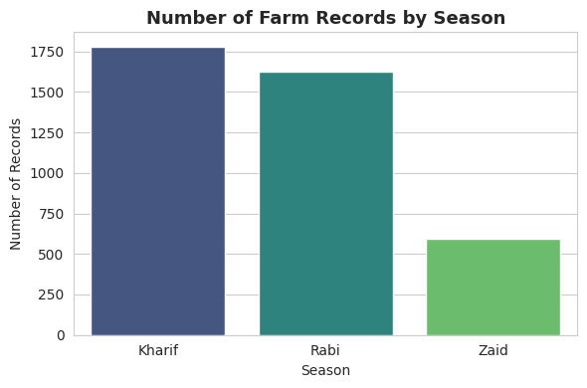
RESULTS
Kharif has the most farm records, followed by Rabi and Zaid — reflecting typical cropping-season prevalence.

Slide 7
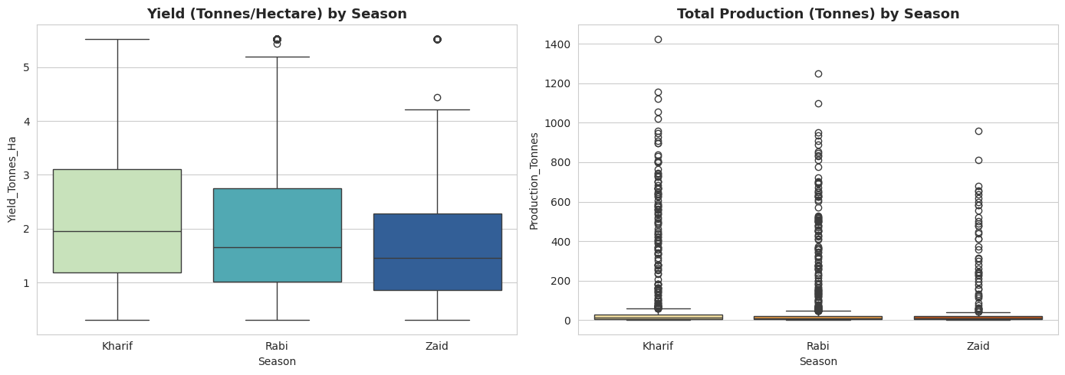
RESULTS
Yield and total production both vary meaningfully across seasons, with visible spread differences season to season.

Slide 8
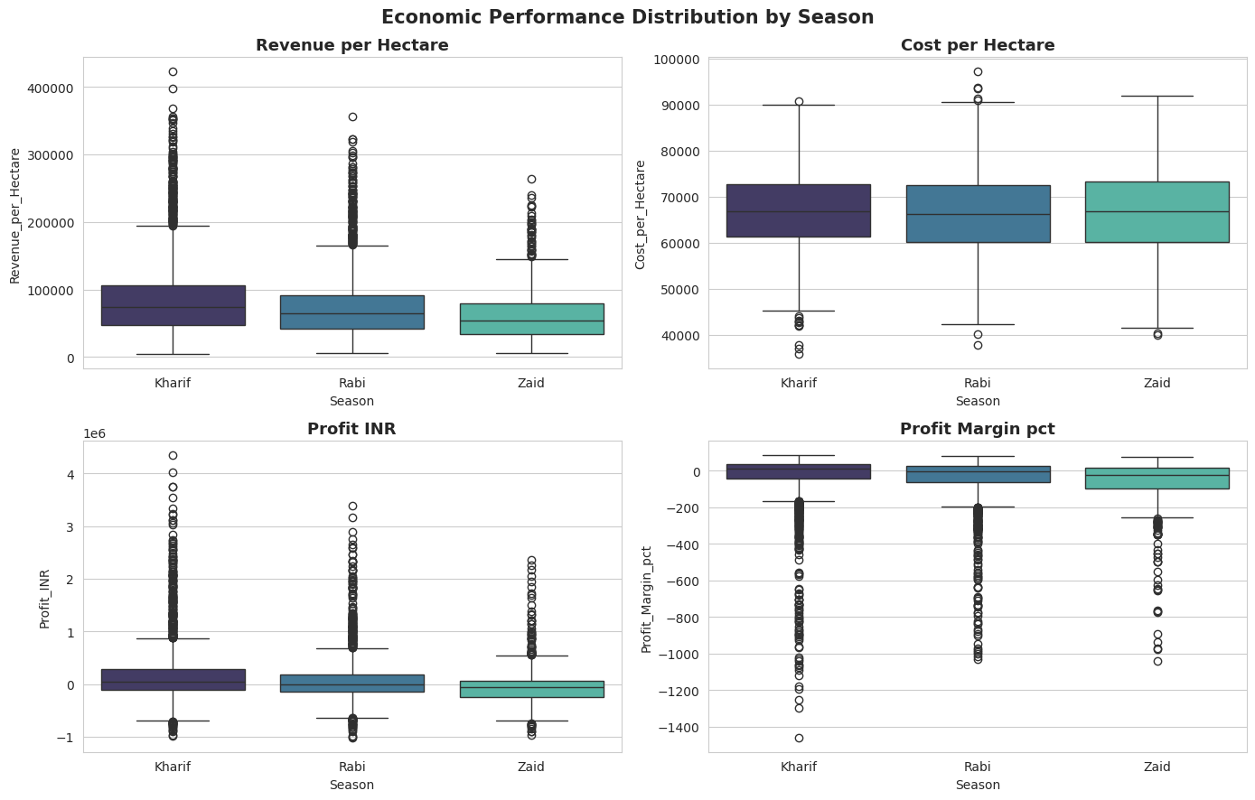
RESULTS
Revenue, cost, profit and profit margin per hectare all differ by season — profit margin highlights efficiency independent of farm size.

Slide 9
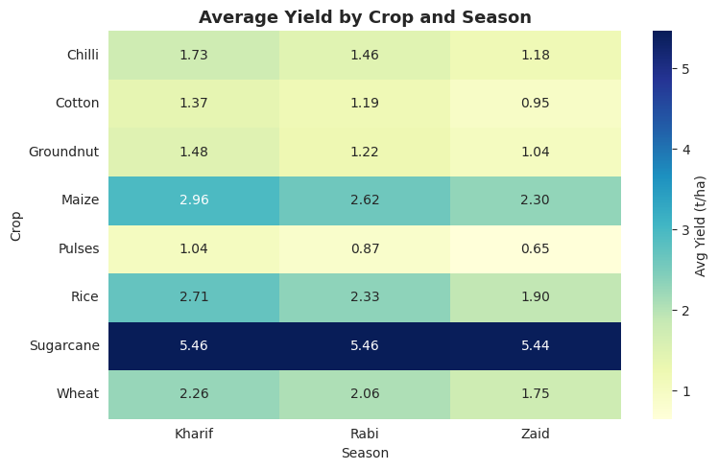
RESULTS
Average yield by crop and season shows that specific crops clearly outperform in specific seasons — useful for season-wise crop planning.

Slide 10
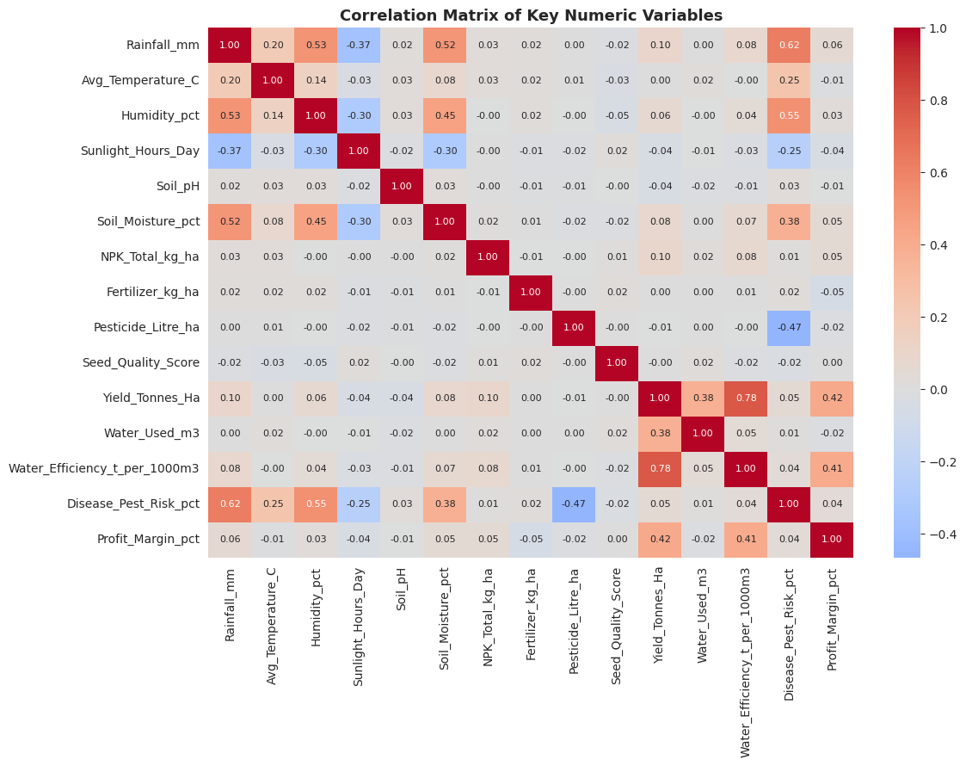
RESULTS
Correlation matrix of key variables highlights the strongest drivers of yield, profit margin and water efficiency.

Slide 11
Future scope
Extend the analysis with multi-year data to capture year-over-year seasonal trends
Build a predictive model (regression / ML) to forecast yield or profit from seasonal and environmental conditions
Incorporate real-time weather and market-price feeds for dynamic, season-aware advisories
Develop an interactive dashboard for farmers and policymakers to explore seasonal patterns
Expand the analysis to more states and crops to improve generalizability of findings

Slide 12
GitHub Link
https://github.com/prashanthimallepula-gif/seasonal-agriculture-performance-analysis

Slide 13
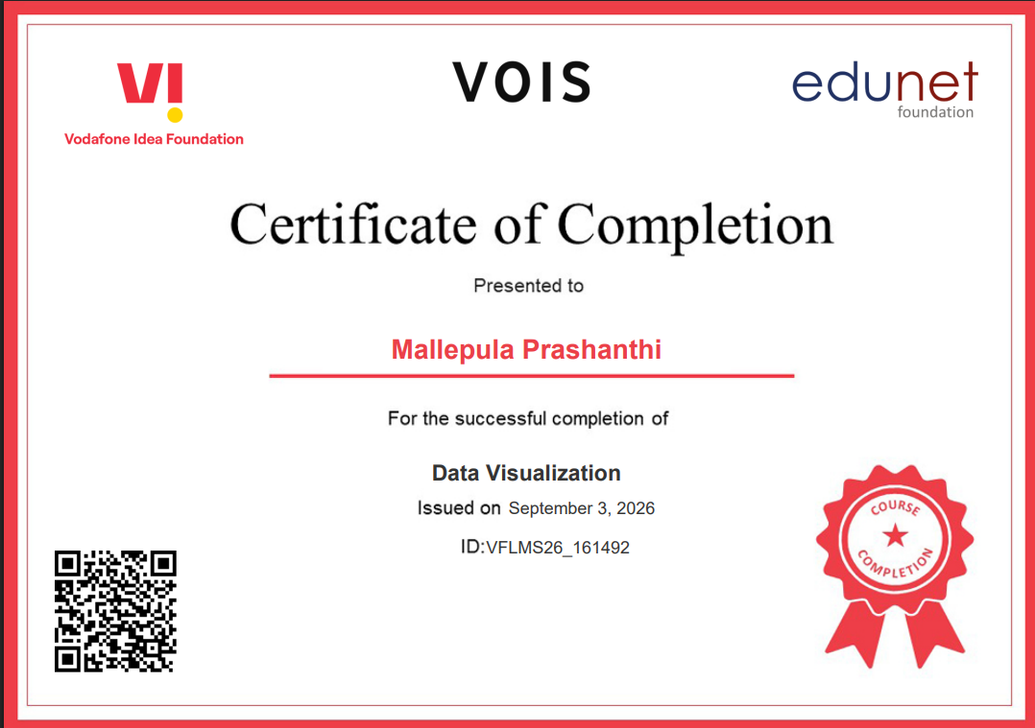
VOIS Course completion certificate - Course name- Data Visualization

Slide 14
Thank you
.
.

